Slide 1
Cavitation, surface tension and fracture
Stephen Millmore
Laboratory for Scientific Computing

Slide 2
Outline
Cavitating flows
Surface forces
Fracture

Slide 3
Outline
Cavitating flows
Surface forces
Fracture

Slide 4
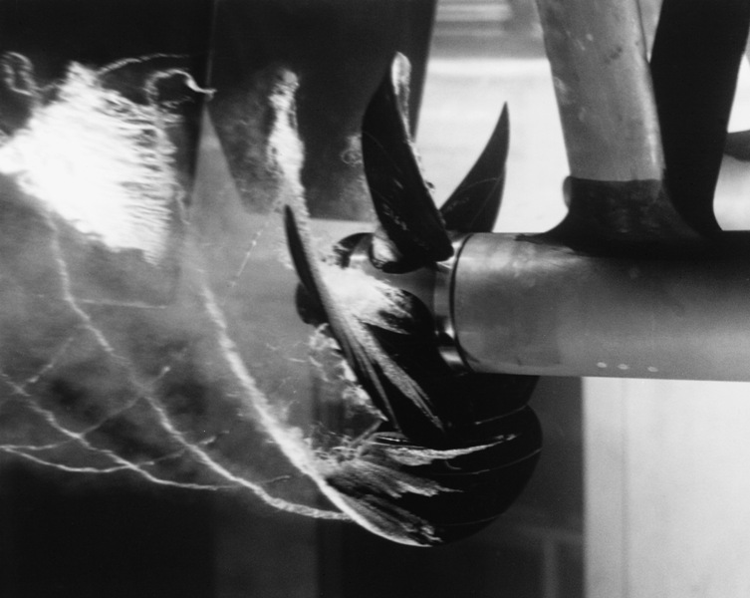
What is cavitation?
Cavitation is pressure-induced phase change of a liquid into a gas (vapour)
Cavitation occurs when pressure drops (below the saturated vapour pressure)
Different mechanism to boiling, which requires temperature to reach saturation temperature
This means a timescale difference – acoustic timescales, not thermal ones

Slide 5
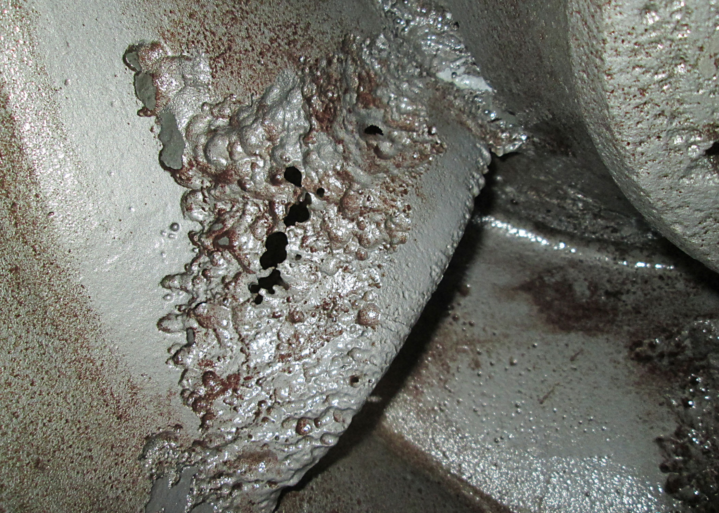
Why do we want to model cavitation
Cavitation can be a very damaging profile, for example, in turbines
Bubbles are formed, and when they burst, a shock wave is released
This can cause erosion
Additionally, the flow through the material changes in properties, this leads to inefficiency

Slide 6
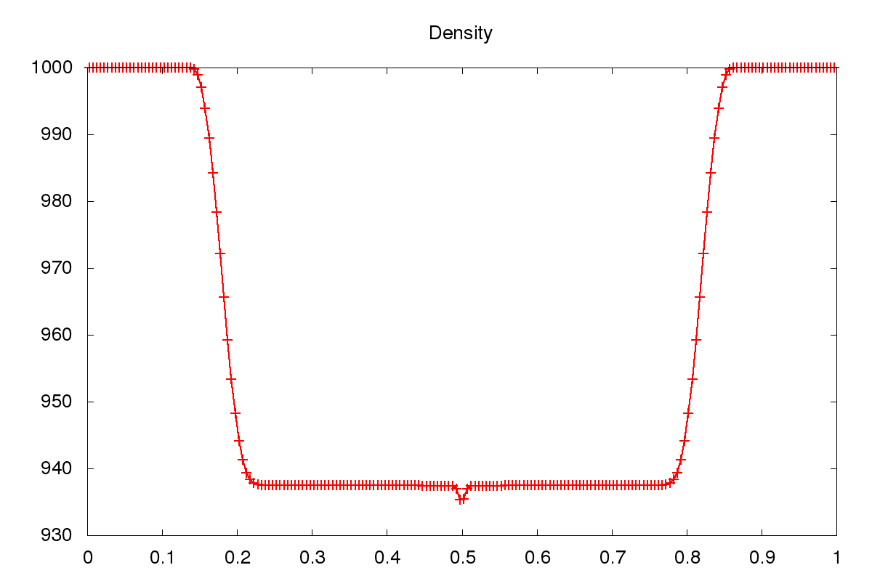
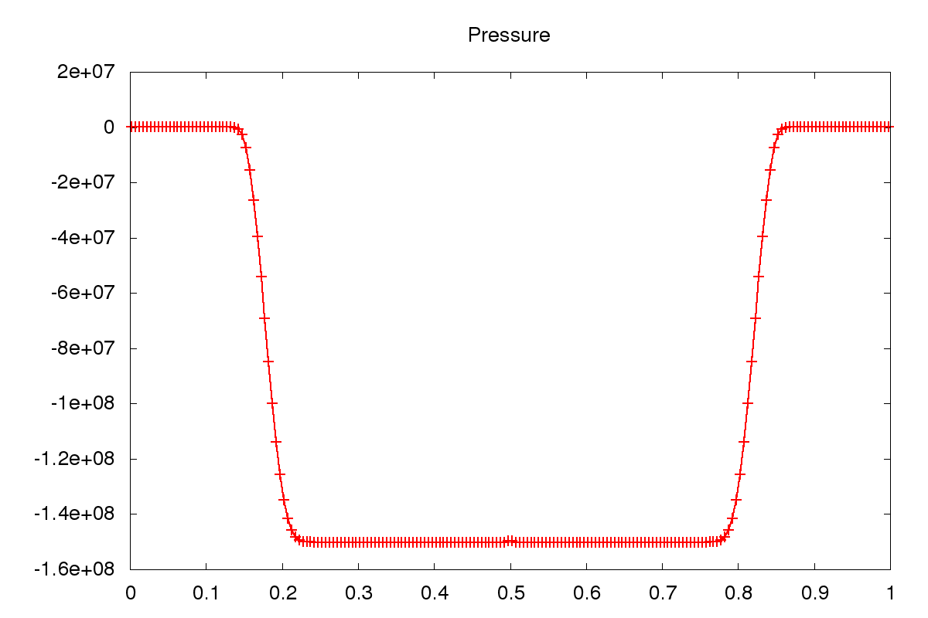
Liquids in tension
The stiffened gas EoS does not allow for cavitation to happen by itself
We could consider a complex, more accurate EoS, and extra terms to model cavitation
Alternatively, we can consider a multiphysics approach

Slide 7
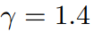
Diffuse interface approach
A multiphysics approach means we will treat water and water vapour as two different materials
Because we need phase change, we have to use a diffuse interface formualtion
Additionally, we need to know when water has reached the saturation pressure, and will cavitate; we need two pressures in our model (or two energy equations)
It is common to assume velocity equilibrium between water and vapour, so a six-equation model is used
We also need a vapour EoS – it is standard to assume an ideal gas,

Slide 8
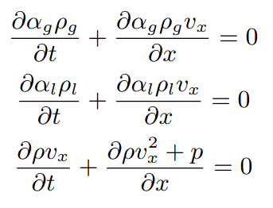
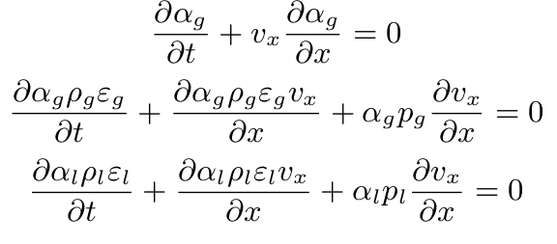
Diffuse interface approach
There are multiple six-equation approaches, here we consider the model of Saurel, Petitpas and Berry (2008)
Here is the model without source terms
Although written in a different form from our first six-equation formulation, it is equivalent
No improvements in conservation, but nothing is worse, either

Slide 9
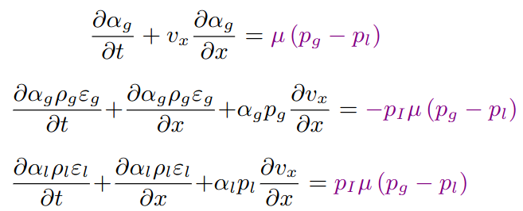
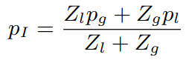
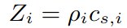
Cavitation terms
The source terms for relaxation are as introduced before
In this case, we only consider a single interfacial pressure – we drop the prime notation
This model also provides a description for the interfacial pressure
The weighting is based on acoustic impedances
. Saurel, Gavrilyuk and Renaud (2003)

Slide 10
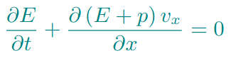
Conservation concerns
It is clear that the non-conservative form will be an issue here
We have already stated how shockwaves are an important consequence of cavitation
Saurel et al. find that adding an additional equation helps here
By additionally evolving the conserved quantity of total energy, conservation errors in specific internal energy can be "corrected"

Slide 11
Pressure relaxation
In order to achieve cavitation, we cannot avoid doing something to deal with these source terms, i.e. we need
The actual timescale over which cavitation occurs is still fast, we can still make the instantaneous relaxation assumption
However, in this case, we don't reduce to the five-equation system since we are saying that this relaxation instantaneously causes phase change
We deal with this in the normal manner for source terms – operator splitting
The actual process, of relaxing to a known state, is similar to how plasticity is accounted for in elastoplastic solids
And it is done through a technique we didn't actually consider when dealing with source terms – analytically solving the ODE (under a few assumptions)

Slide 12
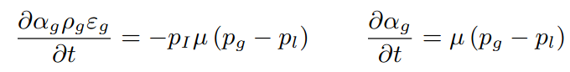
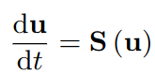
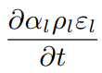
Pressure relaxation
This source term treatment requires the analytic treatment of three coupled source terms
The source term for all other conserved variables simply states that they are constant during the relaxation procedure (which is, itself, important)
In order to solve this, we know that the solution must give
This is sufficient to close the system; we have four independent variables, the two densities, the volume fraction and the new pressure

Slide 13
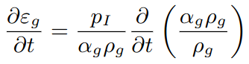
Pressure relaxation
The first step is to remove , since we don't want to deal with quantities tending to infinity
We do this by combining these two equations, and using the fact that the conserved terms are constant during this source treatment
The aim here is to be able to write the source term as a relationship between specific internal energy and density (and remove volume fraction) - then we can use the equation of state to equilibrate pressure

Slide 14
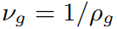
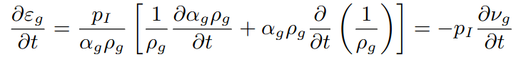
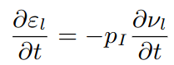
Pressure relaxation
As with the other cases in which we have worked with equations of state, it works out neater (or, at least, follows the literature) if we use specific volume
We obtain a direct relationship between specific internal energy and specific volume
Following the same process of removing the relaxation parameter, but for the liquid, gives
Treating the source term analytically means we now have to integrate these two quantities

Slide 15
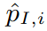
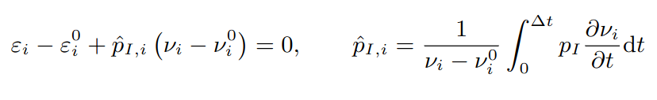
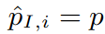
Pressure relaxation
We use a subscript for either the gas or the liquid states
All quantities with superscript 0 are the initial states computed in the balance-law update part
It is at this step, an approximation is necessary – we don't know how to compute a
Saurel show that we can assume that is sufficient, where pressure without any subscript is the single relaxed pressure that both liquid and gas reach through cavitation
This assumption is consistent with instantaneous relaxation, the interfacial pressure immediately becomes the relaxed pressure

Slide 16
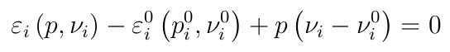
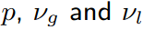
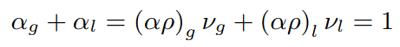
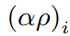
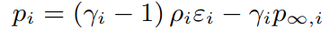
Pressure relaxation
Using the equation of state, we now have two equations,
Since we have three unknowns, and , we need to close the system – the volume fraction relationship is sufficient here:
Because quantities are conserved, we already know these in the relaxed state
At this stage, the derivation has been quite general. If we stiffened gas (or ideal gas) equations of state, we can even solve this analytically
Other EoS may require a root-finding procedure

Slide 17
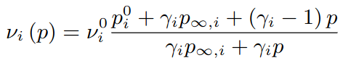
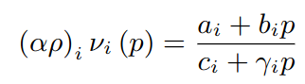
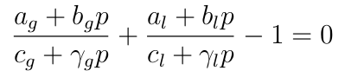
Pressure relaxation
Using the equation of state, we get
Our closure of this system came from the relationship between the two volume fractions – these can be obtained through
This gives
When rearranged, this is just a quadratic equation for the relaxed pressure

Slide 18
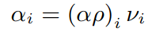
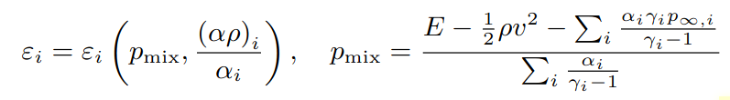
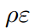
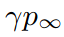
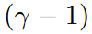
Pressure relaxation
The negative root of this equation gives the relaxed pressure (one between the two initial values)
Once this has been found, the two densities and new volume fractions can be found through
The equation of state could now be used to compute the specific internal energy, but this is where Saurel et al. apply a correction term to help conservation
This is done by obtaining a pressure directly from the conservative total energy evolution
Total
Mixture
Mixture

Slide 19
Notes on implementation
Although standard numerical methods can be used (e.g. primitive variable MUSCL-Hancock with an HLLC approximate Riemann solver), they can be a bit unstable
Typically, an unsplit version is required, and even then, a lower than expected CFL number (around 0.35)
The complex nature of the equations makes it hard to identify stability criteria – such restrictions are often found for diffuse interface systems, and these are typically found by numerical experiment
Additionally, care must be taken to ensure that all computed variables are physical, especially when an approximation is used to compute them
A good example is , which could easily be negative, but physically, it should be within the bounds of both materials, which in this case, means it must be positive

Slide 20
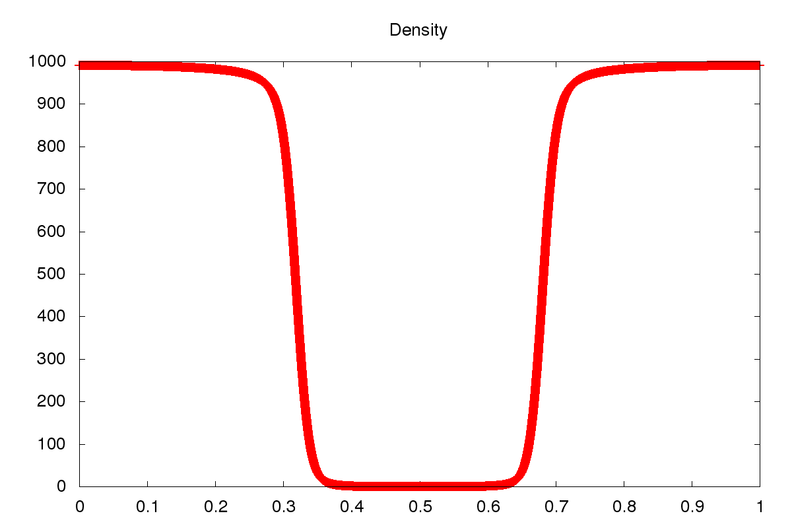
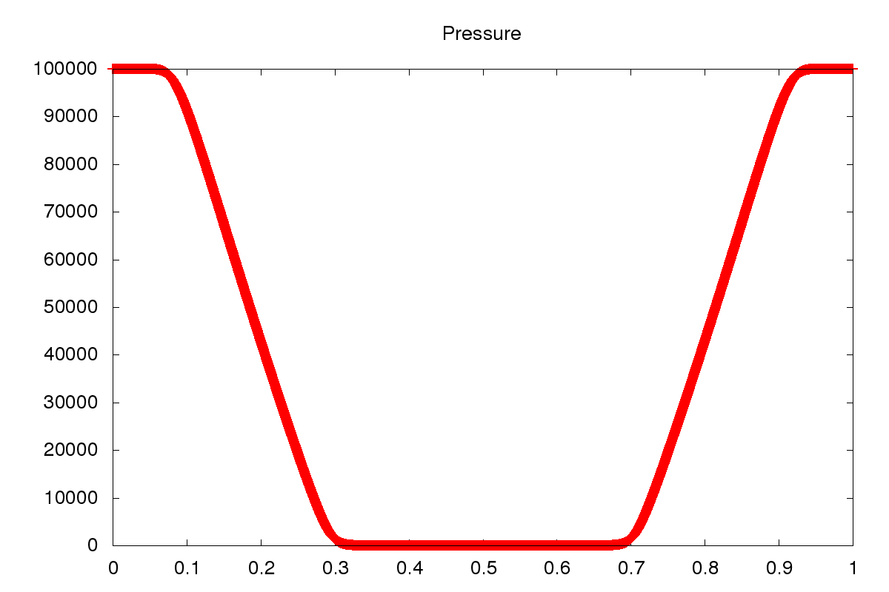
Cavitation models in practice

Slide 21
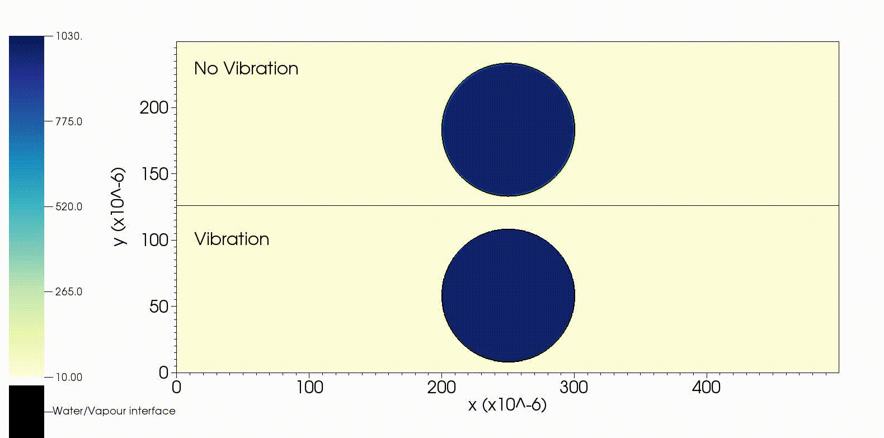
Cavitation models in practice

Slide 22
Outline
Cavitating flows
Surface forces
Fracture

Slide 23
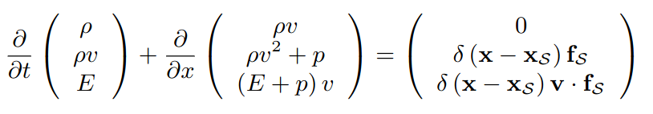
Surface forces
Surface forces are a local force caused by the interaction of two materials at an interface
By their name, they automatically imply a sharp interface, though they could be considered a limit of drag effects between two different materials
Surface tension and friction are two common examples
If you know the force, they are mathematically easy to incorporate, for example, if they act on velocity
In order for a surface force to exist in this specific set of equations, it would have to be part of a sharp interface multiphysics calculation (or there would be no surface), but the same general form can apply to diffuse interface methods

Slide 24
Surface quantities
The delta function here is a result of our finite volume treatment – expressing a force which acts only along a surface as a volumetric quantity
However, this is not great from a numerical method point of view – we compute from our interface representation, which may only be known at cell centres
Almost all the time, this would evaluate as zero
Whilst we could employ some form of interpolation, this could be expensive, and simple, accurate methods exist instead

Slide 25
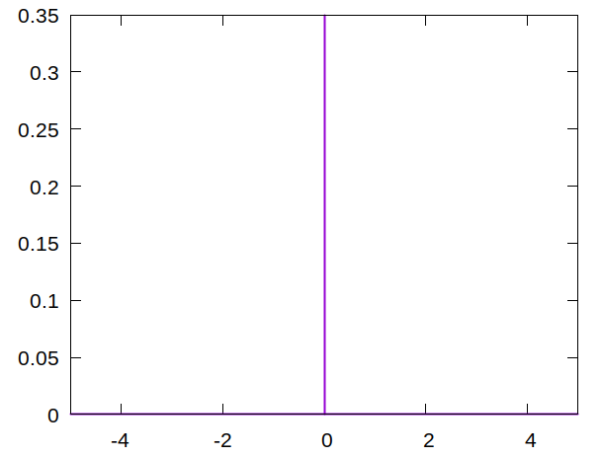
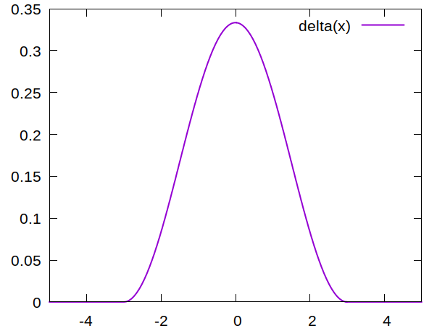
Surface quantities
One technique is to replace the delta function with a smeared approximation
In order to make this approximation, the key feature is that the integral under the smeared delta function must be 1

Slide 26
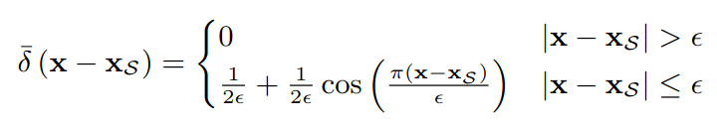
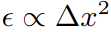
Surface quantities
One typical smeared delta function is
Although it may seem like this should introduce a lot of error, smeared delta functions, with the correct choice of epsilon ( ) are second-order accurate
And they can deal with sharp corners in an interface without issue (which second-order accurate interpolation would struggle with)

Slide 27
Dealing with surface forces – diffuse interfaces
Having a smeared delta function and a smeared interface is an appropriate combination
The source term treatment is then based on what the surface force actually is
Given that we haven't state what the force is, we are hoping that it also can be computed from quantities across a diffuse interface
The challenge may then come from computing the distance
Diffuse interface methods obtain the location of the interface through the volume fraction, which does not have any distance information
We could introduce a level set function too, but this is adding additional computational expense
Alternatively, a smearing based on the volume fraction could be used, but this might be challenging to ensure it obeys the properties of the delta function

Slide 28
Dealing with surface forces – sharp interfaces
Given that surface tension assumes a sharp interface, these methods are a natural choice to use
Here, though, the smearing introduces different problems
We would be combining smeared behaviour and zero-width behaviour at the same interface; this may lead to thermodynamic inconsistency
However, an alternative approach is available – surface forces are effectively a condition on the boundary between the two materials
This might mean we can incorporate them into our dynamic boundary conditions
To see this, we consider a specific example; surface tension

Slide 29
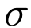
Surface tension
The physics of surface tension lies in molecular behaviour – at an interface, there is an asymmetry in the intermolecular forces due to the sudden change
This creates a force which acts tangentially to the surface – typically represented by the force per unit length between two given materials,
As with most other physical parameters, it needs to be computed either experimentally or from molecular simulations, and there is no reason for it to be constant for differing pressures or temperatures
One key effect of surface tension for multiphysics is that an interface in thermodynamic equilibrium can now sustain a jump in pressure
Effectively, the outwards force of pressure is balanced by the surface tension effects

Slide 30
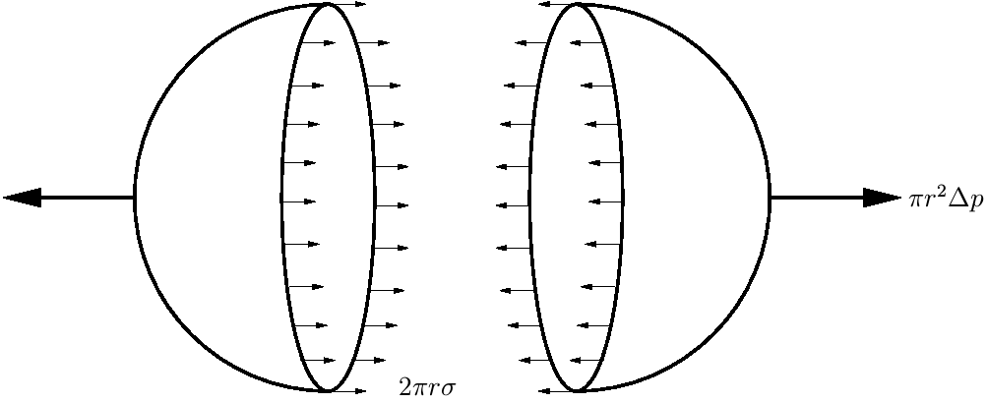
Surface tension
A pressure difference over an interface produces a force normal to the surface
Since surface tension forces are tangential to the interface, they act around the circumference

Slide 31
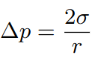
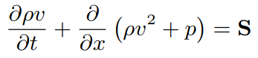
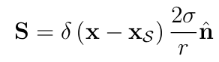
Balancing forces
For this example of a sphere, the balancing of the two forces gives what is sometimes known as the Young-Laplace law
From this, we can start to consider what the surface tension source term should look like, considering the momentum equation
Of course, since we have a discontinuity at the interface, we can't actually use this form, but use an integral form instead
By considering a zero-velocity case, we can show that our surface force is given by

Slide 32
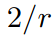
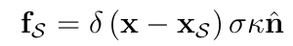
Surface tension
We have a source term for a sphere in equilibrium, in general, we have neither spheres nor equilibria
However, intuitively we can extend this – the surface force requires there to be some curvature of the interface, and a sphere has curvature
Generalising this (which could be done rigorously), we get
This adds an additional complication for diffuse interface methods – the curvature and normal vector are not trivial to recover, but techniques exist (e.g. Young's method)
For sharp interface methods, these are straightforward to calculate from the level set function

Slide 33
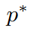


Surface tension as a boundary condition
When we derived dynamic boundary conditions, our first step, in all cases, has been to say we have pressure equilibrium across the interface
This is no longer true, and, in fact, any method that attempts to use naive implementations of sharp interface methods which enforce this may introduce additional waves
If we consider a Riemann-problem based GFM, then the first step is to find
We now have two intermediate pressures, fortunately, we know how they are related; the jump across the interface obeys
This then closes the system for an exact Riemann problem solution

Slide 34
Surface tension as a boundary condition
This method was first published by Fechter, Jaegle and Schleper (2013)
Originally it was applied to Lagrangian material interfaces, but ultimately to the solution of a mixed-material Riemann problem
The presence of the curvature term doesn't alter the fact that exact solvers (or linearised ones) can still be used, though iterative methods may find it easier to reach an unphysical negative pressure which prevents convergence
One important note is that curvature contains second derivatives, and this does have a negative impact on time step
It is obvious in diffuse interface methods, but still present in sharp interface methods
Other surface forces may have similar treatments, but would require derivation of any variable jumps across the interface

Slide 35

Surface tension example

Slide 36
Outline
Cavitating flows
Surface forces
Fracture

Slide 37
Fracture and multiphysics
In many ways, fracture may seem to be a single material problem - one material is simply breaking and falling apart
However, this process creates an interface; a feature along which the solid material stops - there must be a second material the other side of it
This material depends on the solid you are modelling; is it in air? Underwater? Blowing up (i.e. surrounded by explosive)? In vacuum? (Note - many "conventional" codes always model solids in vacuum)
The presence of the additional material(s) doesn’t provide the largest challenge of modelling solids (we’ve already covered the techniques for this), but how we actually generate the fracture itself
The challenges are how do we actually determine where this fracture is going to occur? And how do we model the creation of the new interfaces that arise

Slide 38
Damage
Fracture is not simply a case of a material moving from being one piece to two pieces
The actual process is complex; stress and strain can cause regions of a solid to separate at the atomistic level
These are referred to as micro-voids, and further stress and strain can either cause these to grow, or additional micro-voids to appear
Eventually, these become sufficiently large to be visible as a crack in the solid (fracture)
From a continuum modelling perspective, these micro-voids cannot be individually modelled, instead we treat them as a continuum parameter, damage
The behaviour of this damage is then governed by evolution equations, and requires a physical model to describe it (much like plasticity)

Slide 39


Damage modelling
Unsurprisingly, modelling damage is very material specific, and even then, many damage models may exist for a given material
One of the key challenges is that damage may be directionally dependent, either due to anisotropic materials, or the direction of stress and strain
If we take a plane through a material, with area , then Bonora (1997) defines damage as the fractional area of this plane occupied by the micro-voids,
Much like stress, this is a tensorial quantity, and will change depending on the plane
However, for isotropic materials, we can often get away with using a scalar damage model, i.e. damage is a single scalar quantity

Slide 40
Approaches to fracture
Lagrangian:
Element removal – any element which exceeds some damage threshold is simply deleted – simple, and very non-conservative
Fracture along element boundaries (cohesive zome method) - conservative, but your mesh can define your fracture pattern
Eulerian:
Level set-based – seemingly natural since fracture creates sharp interfaces, but defining where fracture happens is hard
Diffuse interface-based – surprisingly straightforward and appropriate, or possibly unsurprising, since it simply scales up the micro-void-to-damage assumption

Slide 41
Level set-based fracture
In many ways, it might seem like the sharp interfaces of level set methods are ideal for fracture, at least for metals, where the cracks are often clean
Indeed, actually setting up the level set function for the fracture is not too difficult
The challenges, though, are:
When a crack appears, it will initially be very narrow, and would require two interfaces in a single cell
When a crack appears, there is a new material within the crack which needs to be given a physical state; unless this state is vacuum, its properties are unclear
Technically, a cell-deletion approach could also be used, but this is either extremely non-conservative, or requires a tricky mass, momentum and energy redistribution
Techniques do exist, but are active research topics

Slide 42



Diffuse interface fracture
To start with, we need a diffuse interface system where one of the materials is a solid
We use the work of Wallis et al. (2021)
Volume fraction equation as before
Each material still has its own density
Still a single momentum and total energy equation, i.e. velocity and pressure equilibrium
A mixture rule exists for obtaining a mixture stress

Slide 43

Diffuse interface fracture
To start with, we need a diffuse interface system where one of the materials is a solid
We use the work of Wallis et al. (2021)
The deformation gradient has been replaced with the unimodular left stretch tensor

Slide 44

Unimodular left stretch tensor
This is a polar decomposition of the elastic components of the deformation gradient (and therefore isn't technically a tensor)
Essentially, the deformation gradient is a rotation of the stretch tensor
It was shown by Ortega, Lombardini, Pullin and Meiron (2014) that using this formulation avoided issues when one material splits, and then rejoins, but each side of the interface before rejoining has very different deformation gradient
The stretch tensor itself is a measure of strain, related to the Hencky strain,

Slide 45
Diffuse interface fracture
To start with, we need a diffuse interface system where one of the materials is a solid
We use the work of Wallis et al. (2021)
The evolution of plastic effects has been replaced with the evolution of a history parameter
This can then include damage, and can be used by the EoS

Slide 46


Damaging materials
In order to achieve fracture in this model, we need to include damage as part of the material history
The left hand side of this equation simply advects existing damage around, the right hand side is where we specify how the damage occurs
We shall ignore plasticity for now, and assume the only history is the damage history
Whilst we allow a damage model for every material, for completeness, in some cases this equation can be ignored, e.g.

Slide 47

Damaging materials
In order to provide some form of damage source term for the continuum damage approximation, we start with the effect damage has on stress
If a damaged material is placed under a certain stress, , if it is damaged, it will behave as if it were under a higher stress, the effective stress
The next step is to assume the strain equivalence principle, that the strain a damaged material experiences is given by evaluating strain under the effective stress
A direct result of this is many material properties can be considered to be linearly degraded due to damage, e.g. the shear and bulk moduli, where a tilde quantity is the undamaged value

Slide 48


A damage model
Using this, it is possible to derive a damage evolution equation (see Wallis et al. for full details)
Effective equivalent plastic strain
Material-dependent constants
Young’s modulus (degraded)
Volumetric shear strain (from EoS)

Slide 49
Numerical approach
The numerical technique for dealing with the damage source term is described, in detail, in Wallis, Barton and Nikiforakis (2021)
Although the source term looks complex, almost everything required actually comes from the plasticity source term updates
This includes the information for computing the time derivative of the effective equivalent plastic strain
For more details on obtaining the plasticity source term update, see Barton (2019)

Slide 50


Fracture prediction

Slide 51

Large-scale fracture

